Slide 1
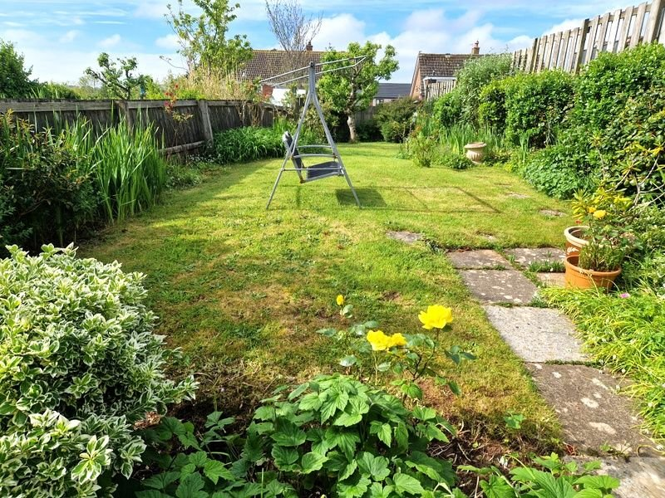
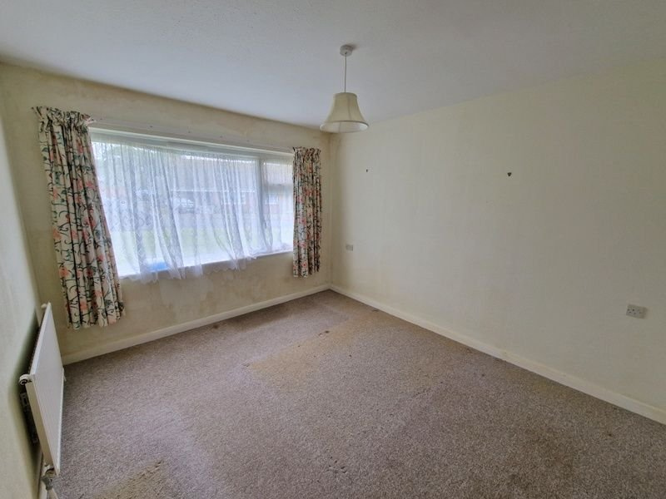
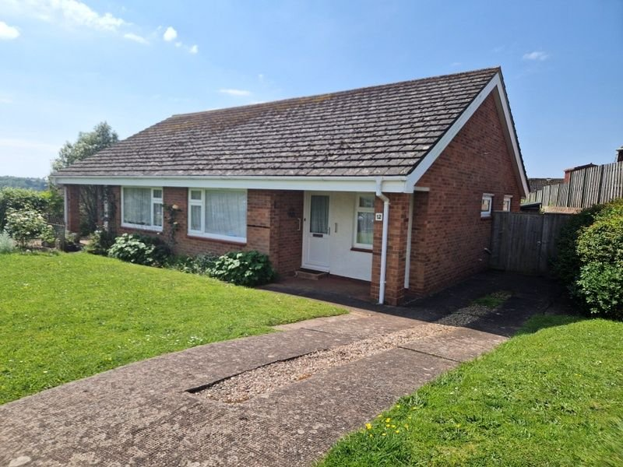
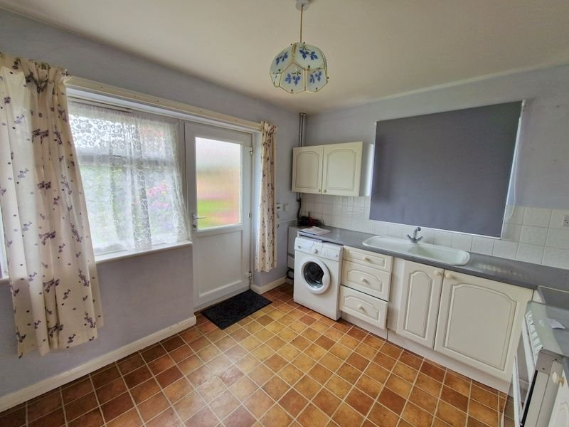
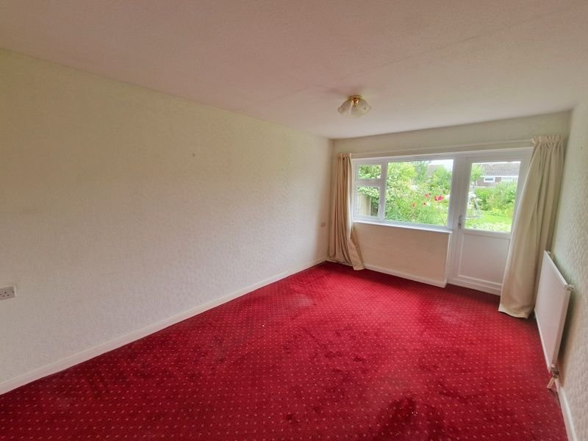
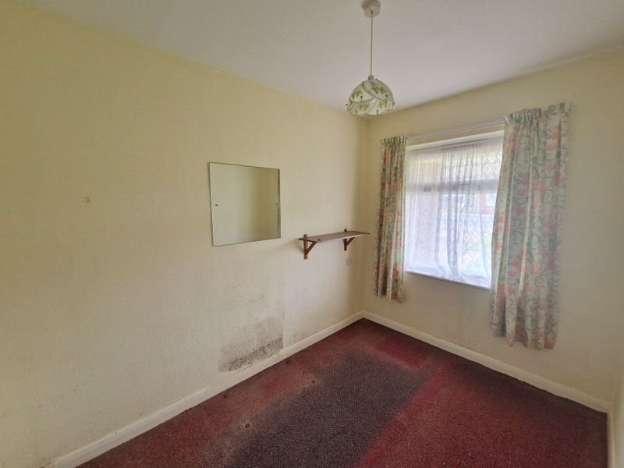
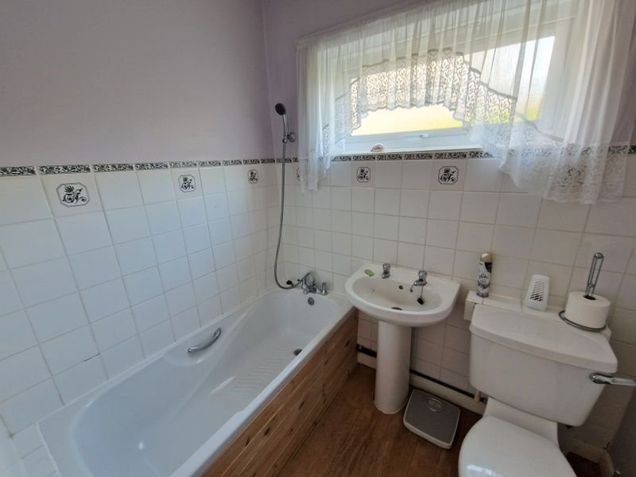
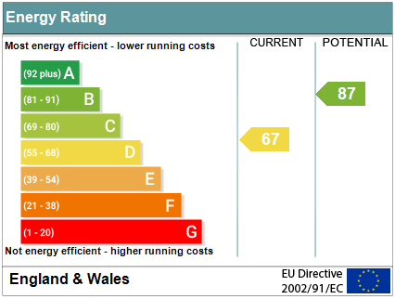
www.pennys.net
12 Winston Road, Exmouth, EX8 4LR
GUIDE PRICE £289,950
TENURE Freehold
A Semi Detached Bungalow With Fabulous Rear Garden, Driveway Parking And Offered For Sale With No Onward Chain.
Lounge • Kitchen/Breakfast Room • Two Bedrooms •
Modern Bathroom/WC •
Gas Central Heating & Double Glazed Windows •
Convenient Location Close to Amenities •
Pennys Estate Agents Limited for themselves and for the vendor of this property whose agents they are give notice that:- (1) These particulars do not constitute any part of an offer or a contract. (2) All statements contained in these particulars are made without responsibility on the part of Pennys Estate Agents Limited. (3) None of the statements contained in these particulars are to be relied upon as a statement or representation of fact. (4) Any intending purchaser must satisfy himself/herself by inspection or otherwise as to the correctness of each of the statements contained in these particulars. (5) The vendor does not make or give and neither do Pennys Estate Agents Limited nor any person in their employment has any authority to make or give any representation or warranty whatever in relation to this property.
PENNYS ESTATE AGENTS
2 Rolle House, Rolle Street, Exmouth, Devon, EX8 2SN
Tel: 01395 264111 EMail: help@pennys.net

Slide 2
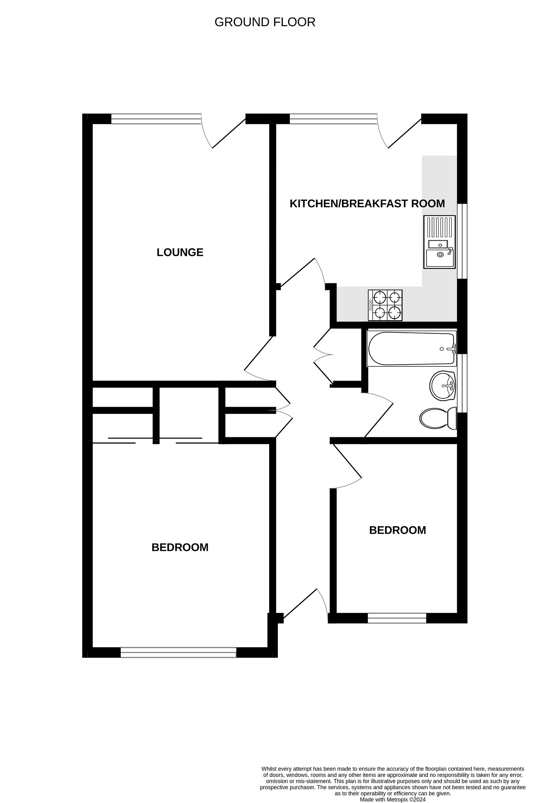
12 Winston Road, Exmouth, EX8 4LR
THE PROPERTY COMPRISES: Open entrance porch; double glazed front door to: RECEPTION HALL: Radiator; access to roof space; two storage cupboards; airing cupboard with water cylinder; telephone point. LOUNGE: 4.65m x 3.15m (15'3" x 10'4") Double glazed window and door to rear garden; TV point; telephone point; radiator; fitted cupboards. KITCHEN/BREAKFAST ROOM: 3.05m x 3.25m (10'0" x 10'8") Fitted with a range of work tops with inset single drainer sink unit; cupboards and drawers with plumbing for an automatic washing machine beneath and tiled surrounds; wall mounted cupboards; radiator; double glazed window to side aspect; double glazed door to rear garden; gas and electric cooker points; gas boiler. BEDROOM ONE: 3.66m x 3.18m (12'0" x 10'5") Walk in wardrobe with light; further built in cupboard; radiator; double glazed window to front aspect. BEDROOM TWO: 3.02m x 2.11m (9'11" x 6'11") Double glazed window to front aspect. BATHROOM/WC: 2.62m x 1.52m (8'7" x 5'0") Bath with shower attachment; pedestal wash hand basin; WC with push button flush; tiling to splash prone areas; double glazed window; radiator. OUTSIDE: Lawned front garden and driveway parking; wooden gate giving access to rear garden The rear garden is of generous size, mainly laid to lawn with well stocked flower beds and borders. Concrete terrace areas. Outside tap
FLOOR PLAN

